Slide 1
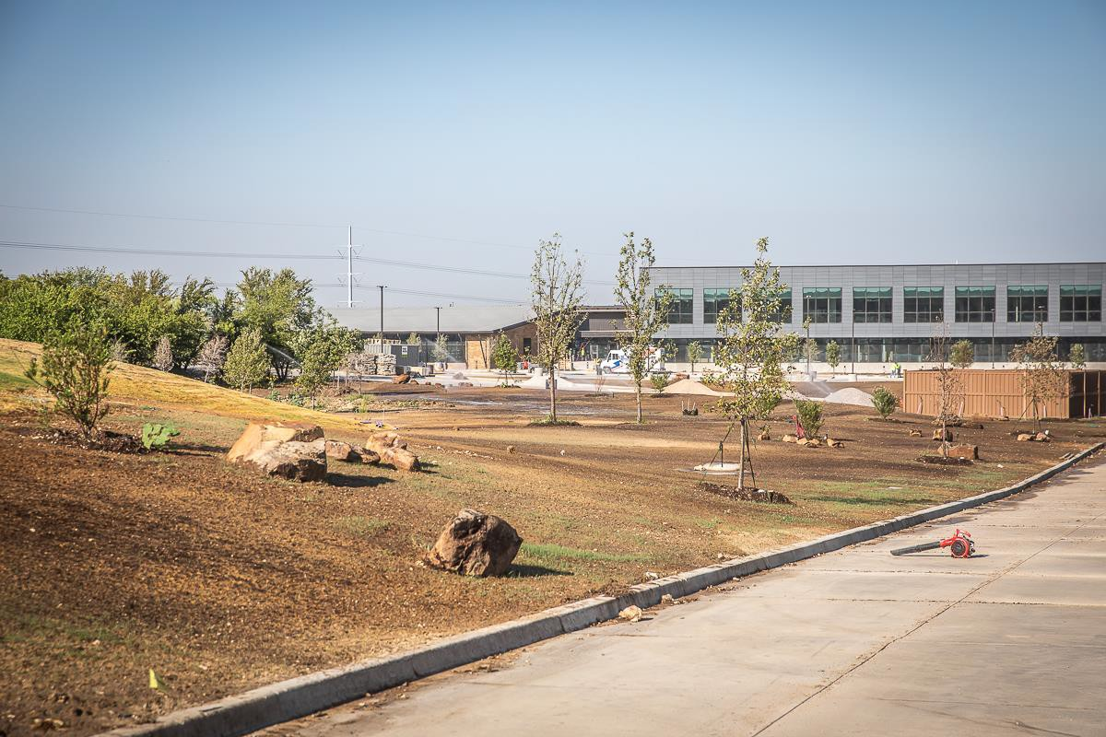
ADMINISTRATION BUILDING
Landscaping continues to progress.

Slide 2
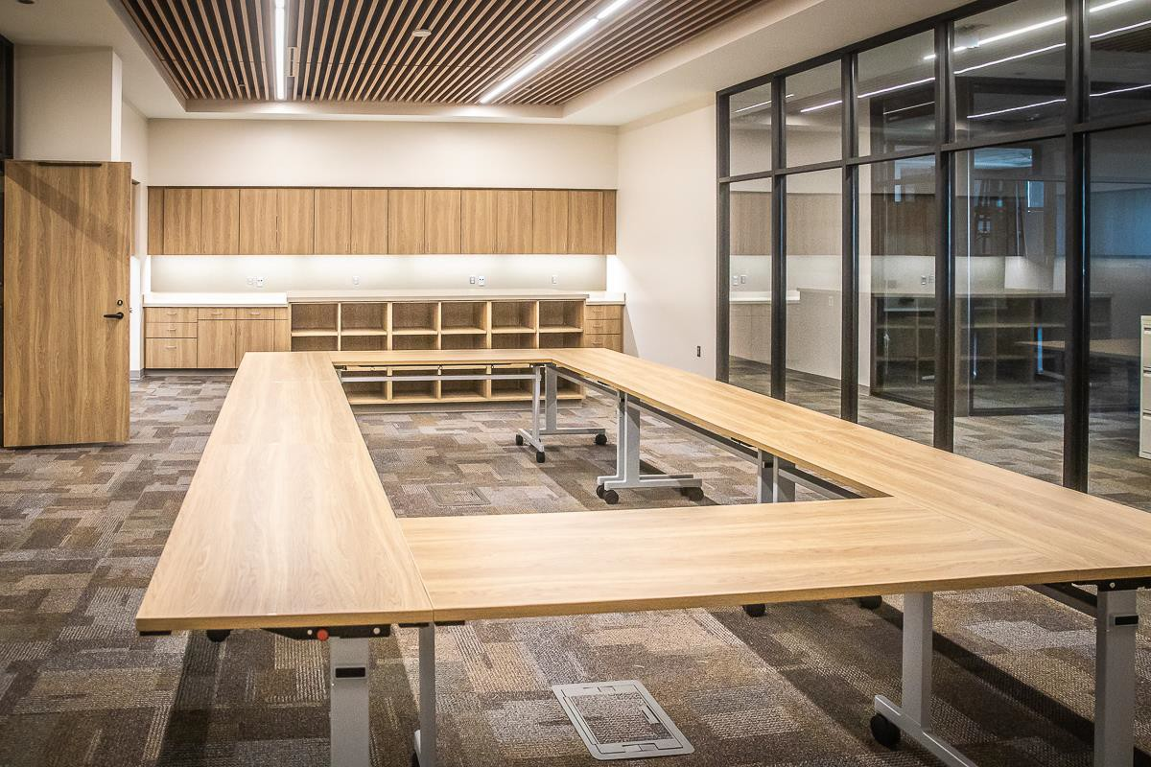
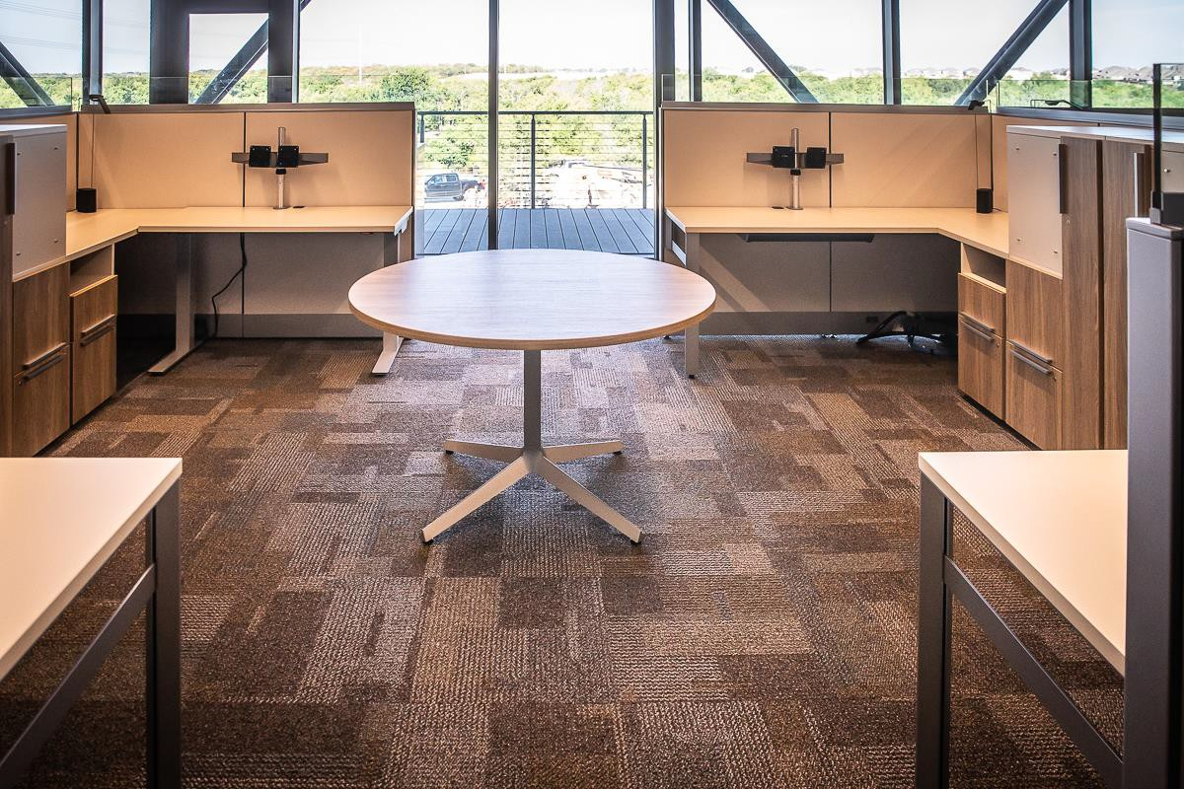
Furniture has been installed in Area C and punch items are still progressing.

Slide 3
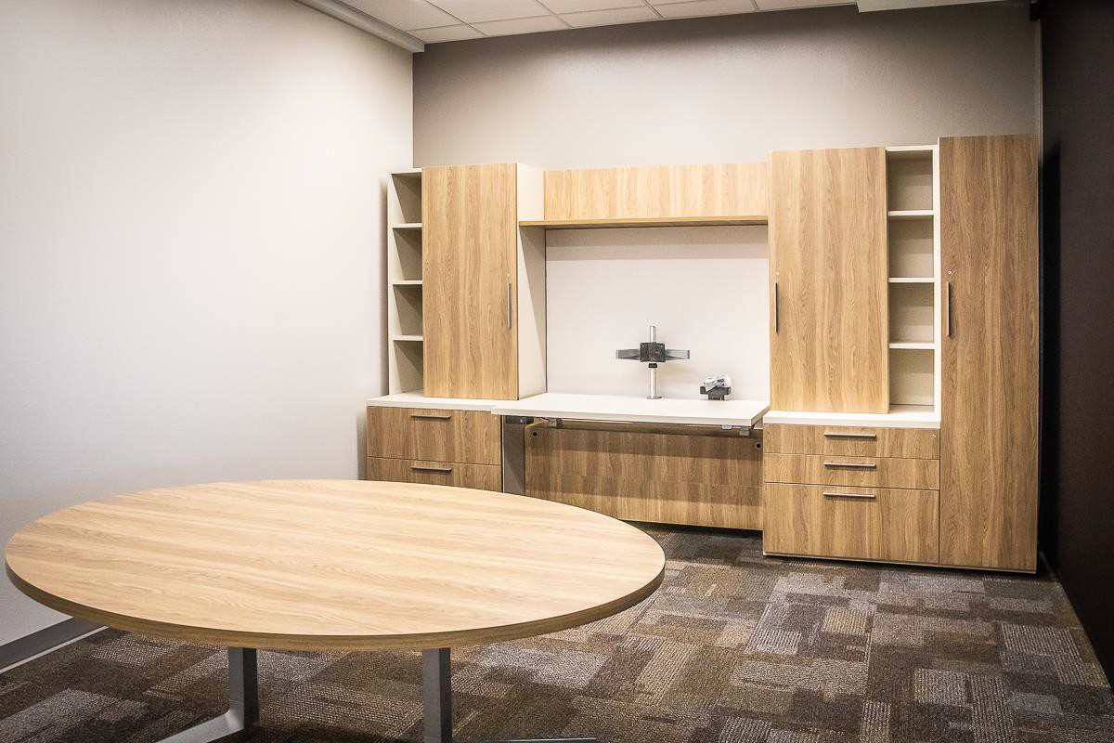
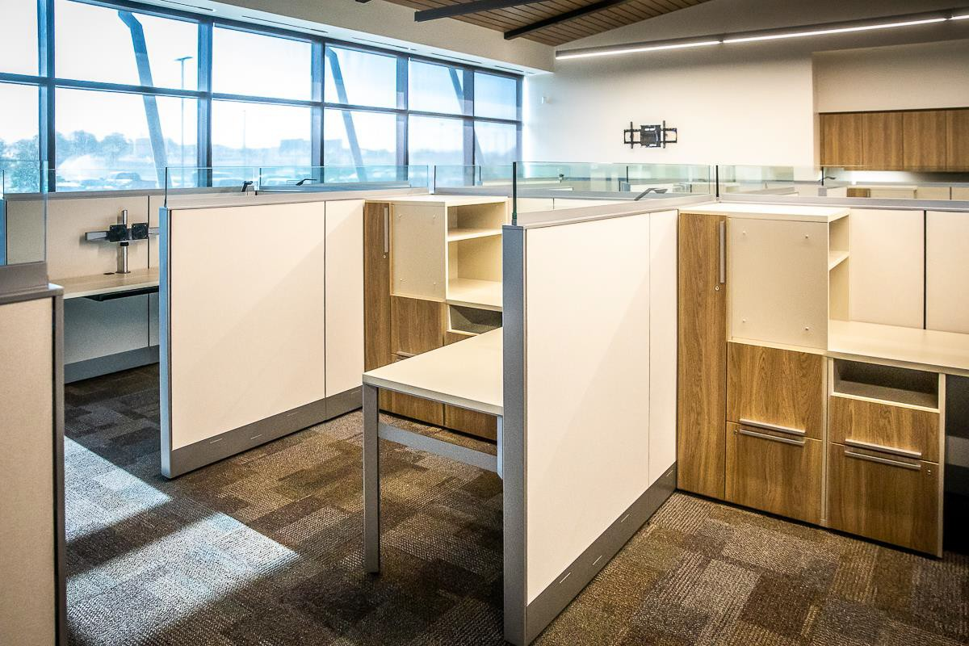
These photos show furniture in communications and business services.

Slide 4
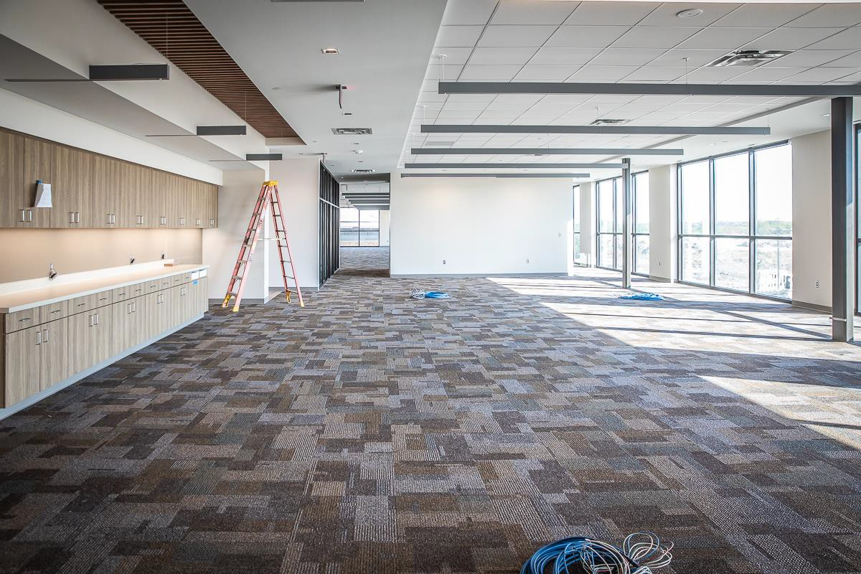
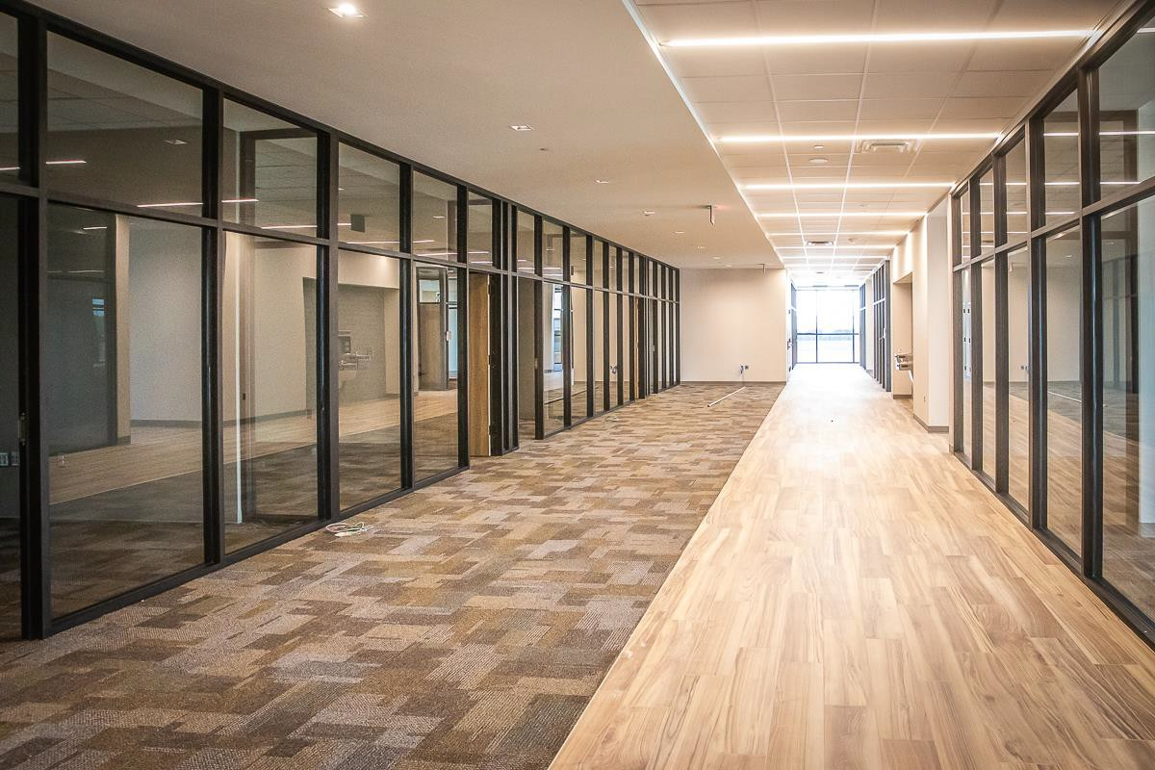
The final cleaning is underway on the upper level.

Slide 5
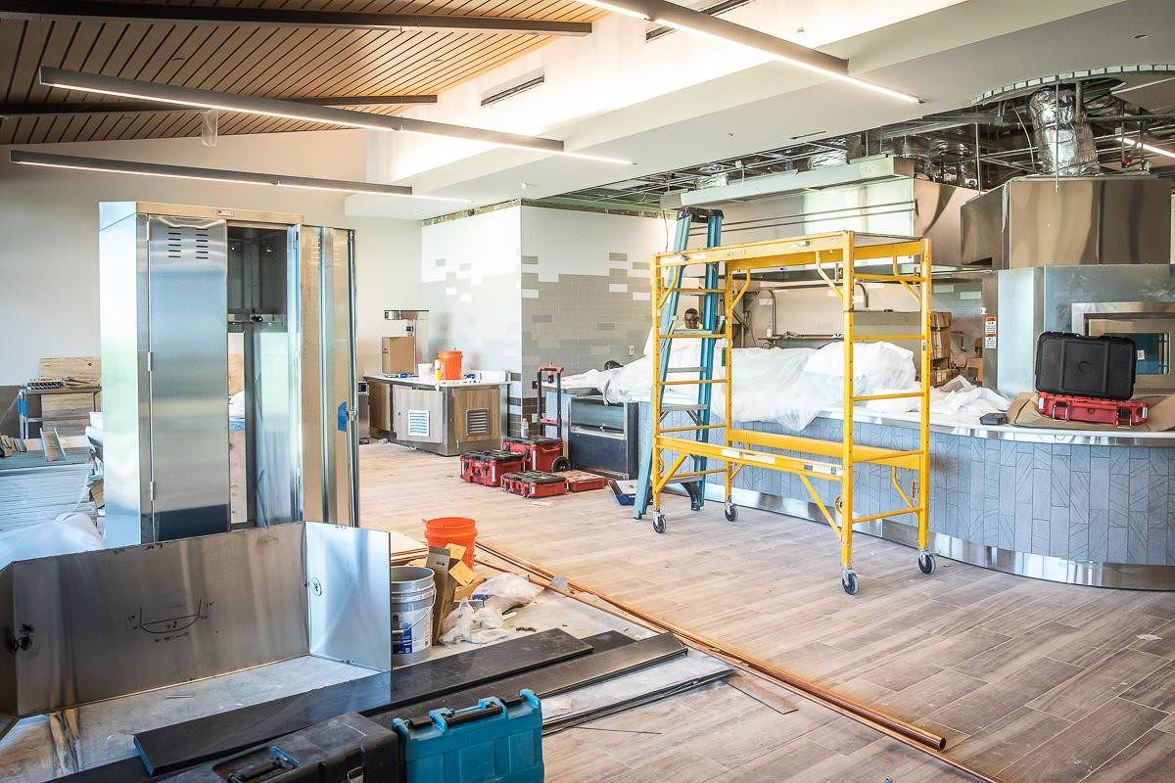
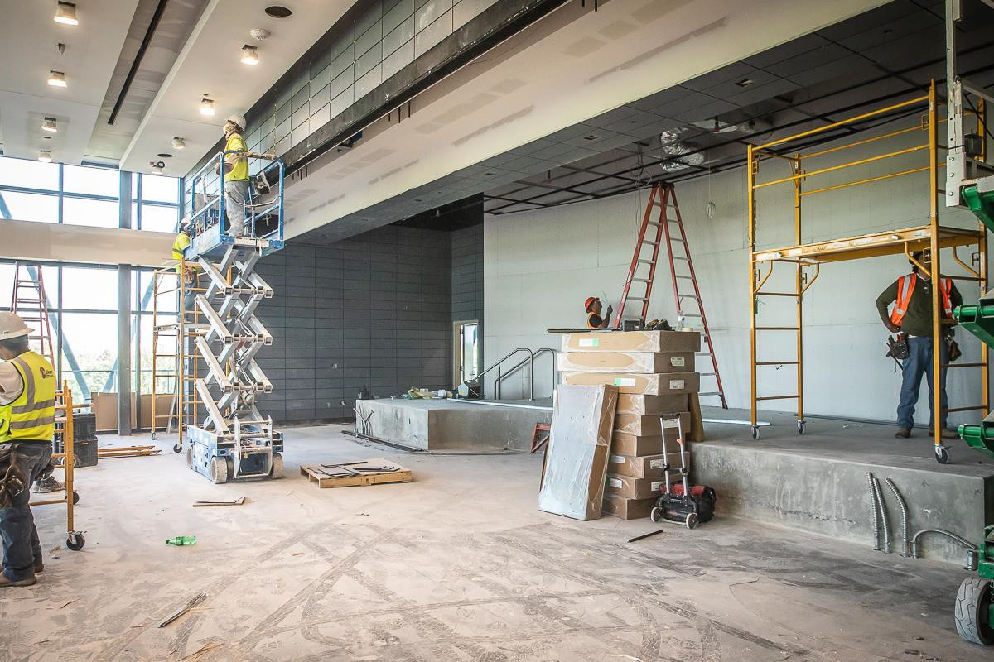
Bistro equipment continues to be installed. Lighting and painting continue in Area A – Board Room.

Slide 6
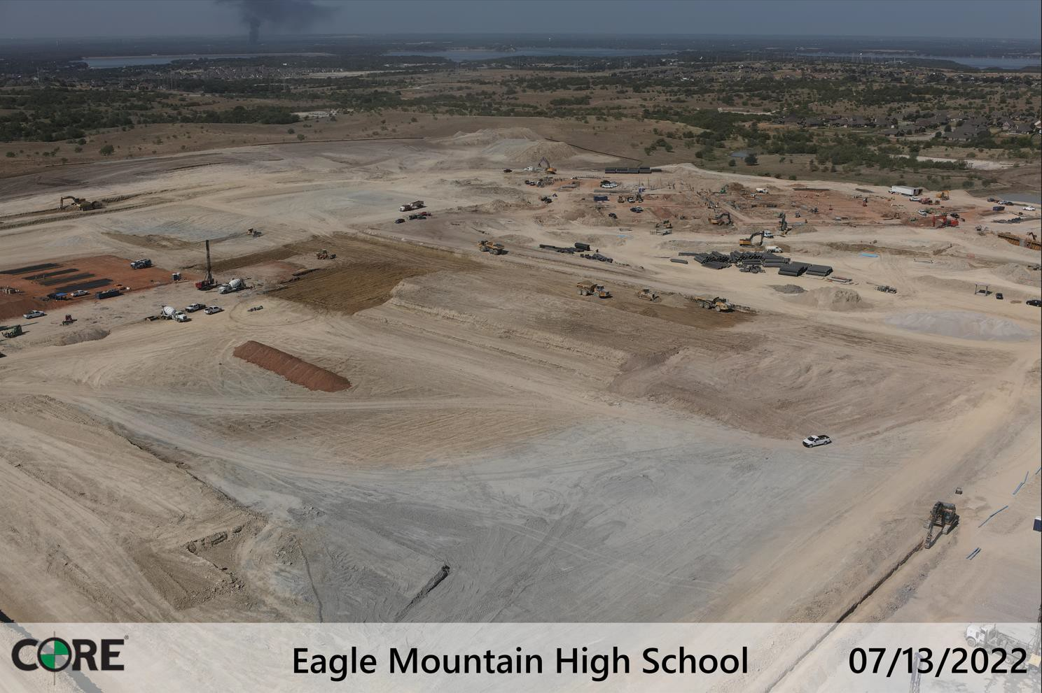
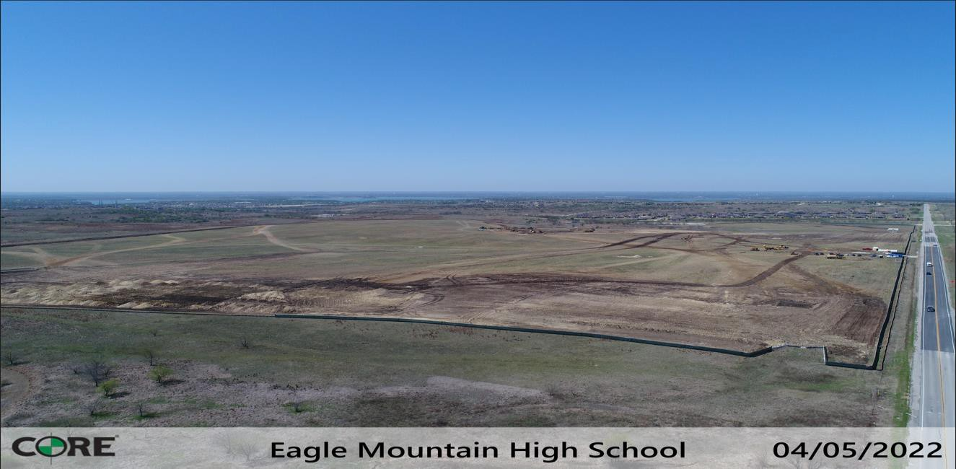
Eagle Mountain HS
This shows three months progress on the eastern portion of the property focusing on the stadium complex.

Slide 7
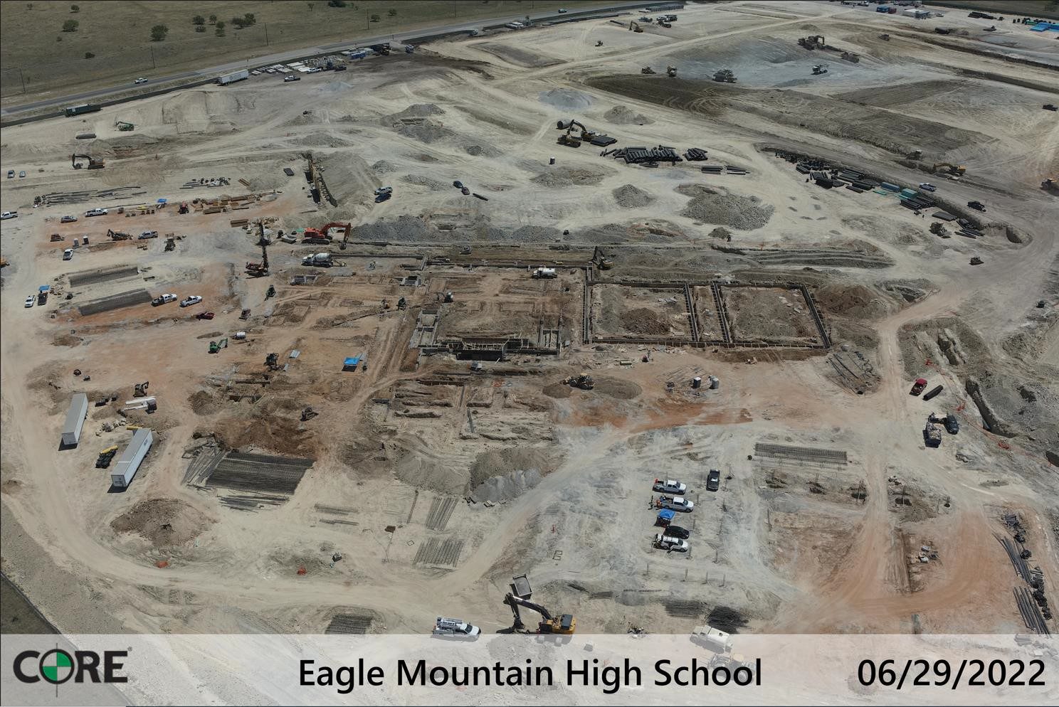
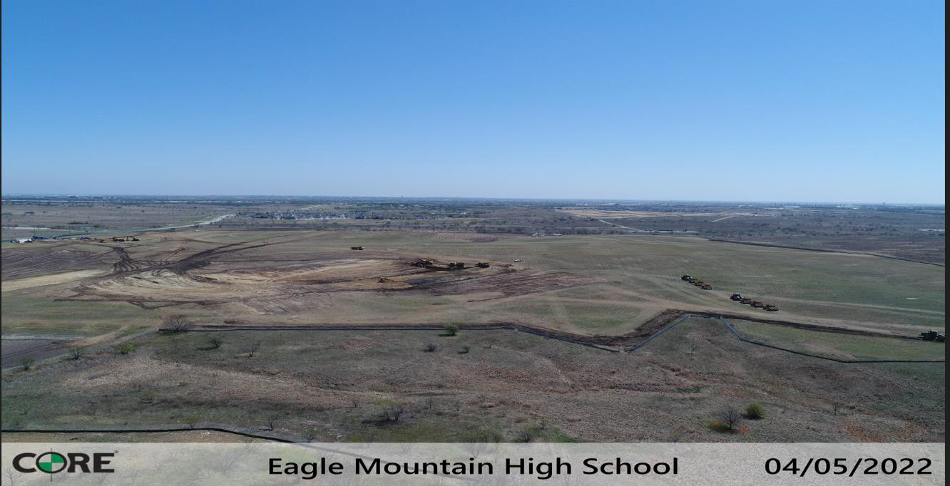
Work continues in the academic, cafeteria, auditorium, and gymnasiums areas. Piers continue to be drilled with over 900 complete. Grade beams, plumbing, electrical, and utilities are in progress.

Slide 8
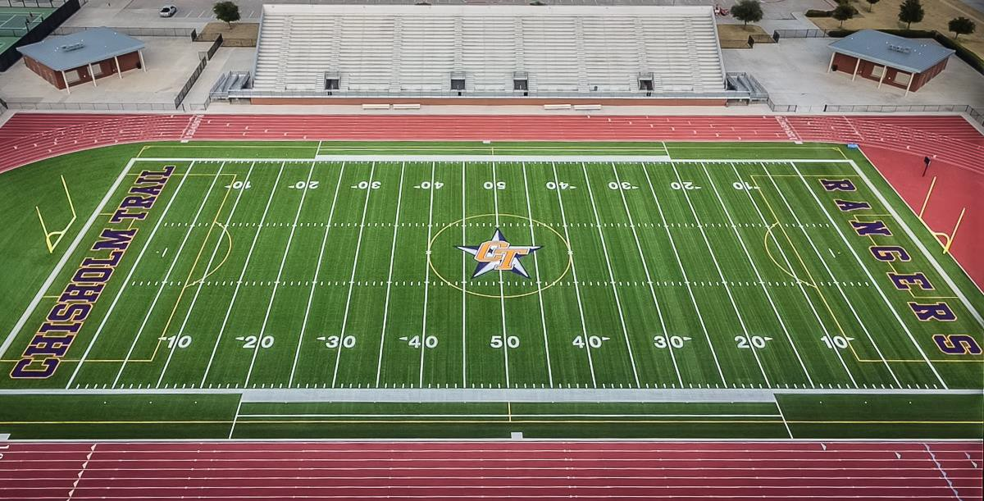
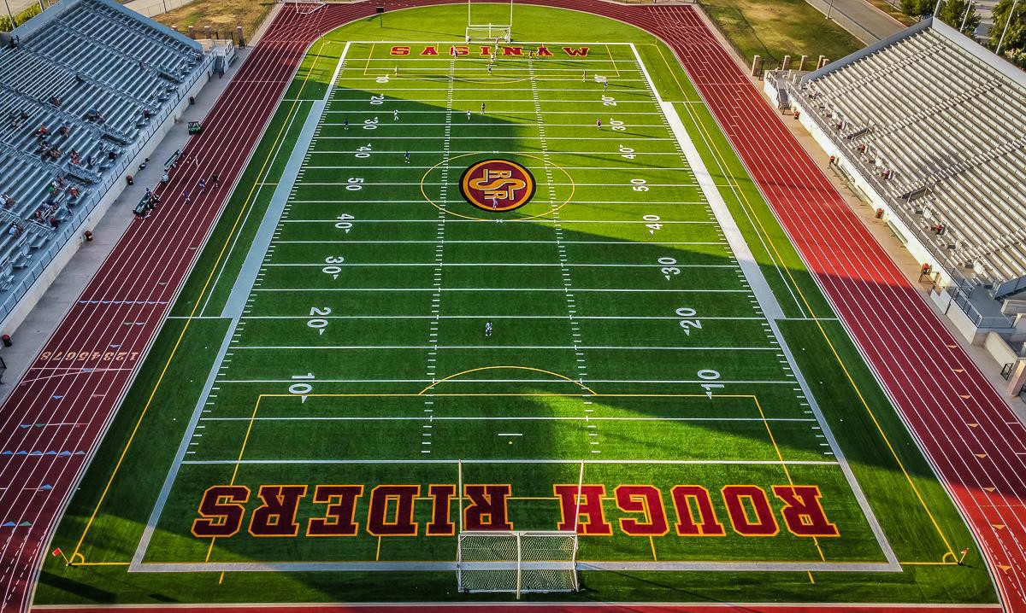
TURF PROJECTS
Turf projects have been turned back over to the schools. Hellas is working on the punch list.

Slide 9
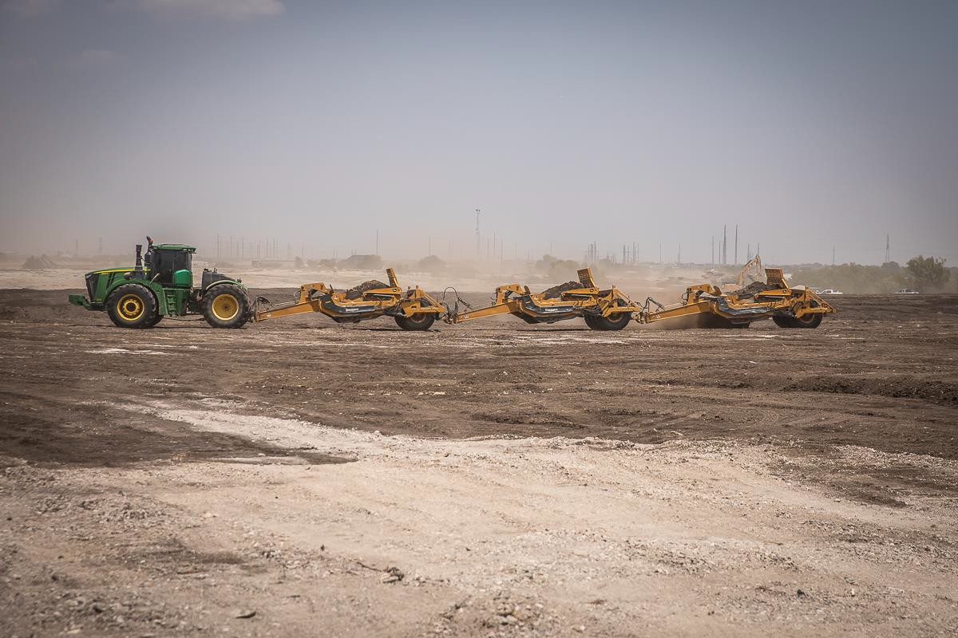
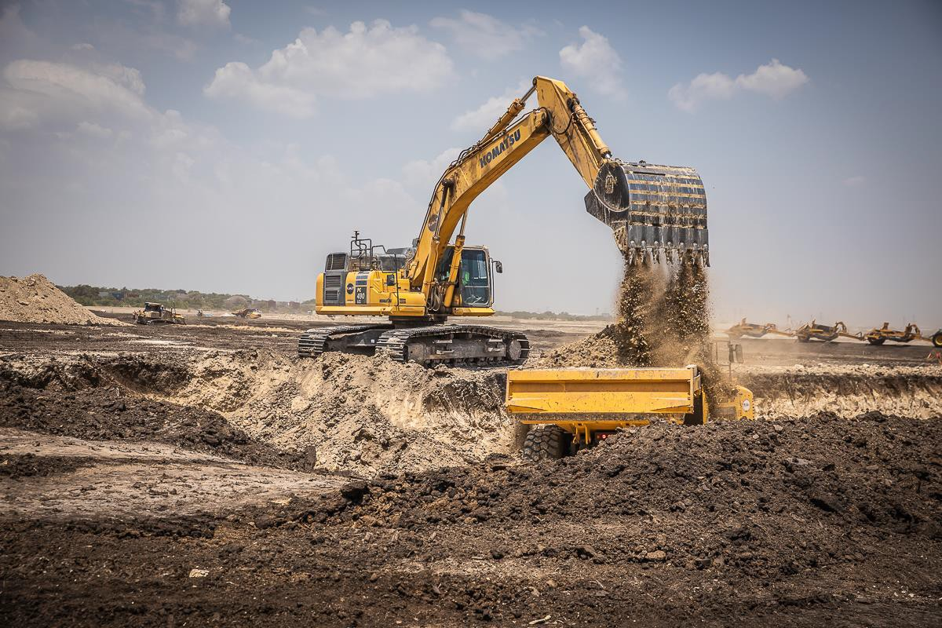
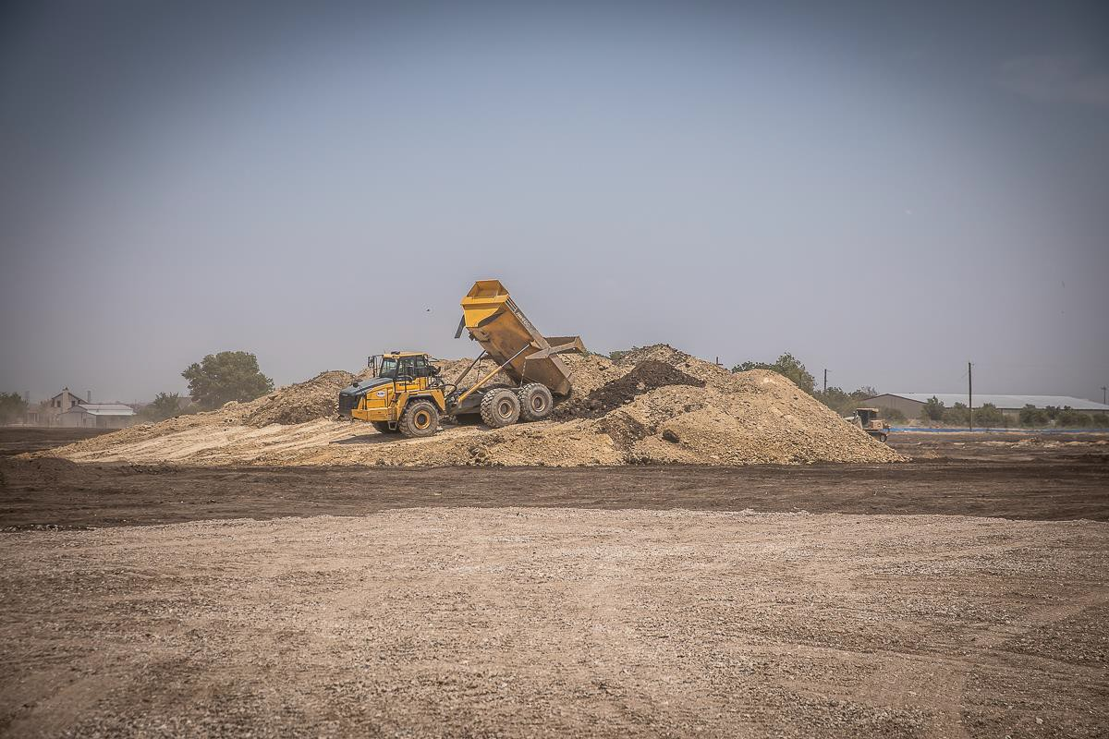
ELEMENTARY 18
Building pad preparation has begun.
Dirt work is in progress.

Slide 10
Wayside MS
Hellas Construction Inc., provided a bid for Track Renovations in the amount of
$134,500.00, consisting of power-washing existing surfacing at the track oval/chutes, high jump pads, and field event runways. This also includes disposal of materials offsite and striping per UIL guidelines.
Hellas Construction Inc., provided a bid for Tennis Renovations in the amount of
$64,620.00, consisting of cleaning off each court with a pressure washer and blower to remove all dirt and debris, and acid wash the new concrete surface. All bird baths will be patched with crack filler. Apply (1) coat of TPS 5000 acrylic surface. Apply (2) coats of TPS 5000 fortified acrylic color coating. Layout and paint 2” wide lines using line tape sealer as primer coat to ensure razor sharp edges. Paint shall be TPS 5000 white line paint and painted in accordance to USTA and ASBA specifications for doubles play.

